Slide 1
Design of Gilbert mixer suited for 5G wireless networks
Double Balanced Active Mixer 180 nm technology
Group Members:
Bata Sai Pavan – 2101EE19
Usakoyala Ram Prasad -2101EE78
Supervisor:
Dr. Yatendra Kumar Singh

Slide 2
Objective
To create a Gilbert mixer suited for a 5G wireless network.
Focus on achieving low noise figures and wide bandwidth for effective frequency conversion.
To achieve a maximum conversion gain
Optimize performance that includes conversion gain, isolation, and power consumption to meet stringent 5G communication standards.
Prioritize stability and reliability through meticulous design, simulation, and testing processes.
Contribute to advancing 5G wireless technology with a dependable mixer solution.

Slide 3
Some Basic Mixers
Down conversion mixer
Single Balanced Down Conversion Gilbert-Cell Mixer

Slide 4
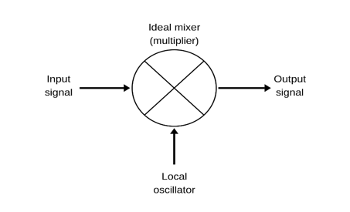
Down Conversion Mixer:
Basic principles:
Frequency Mixing
Nonlinear Operation
Heterodyning
Filtering
Conversion Gain and Isolation
Linearity and Noise Figure
Fig. 1: RF Mixer

Slide 5
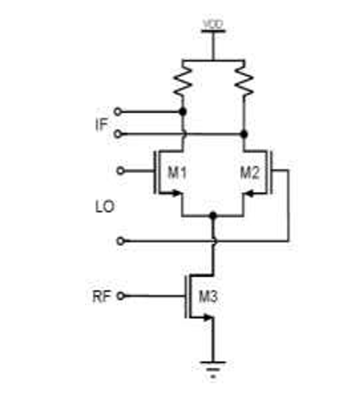
Single Balanced Down Conversion Gilbert-Cell Mixer
Single Balanced Configuration
Transistor-based Implementation
High Linearity and Low Noise Figure
Biasing and Control
Fig. 2: Diagram of single balanced mixer

Slide 6
Double Balanced Active Mixer
180 nm technology

Slide 7
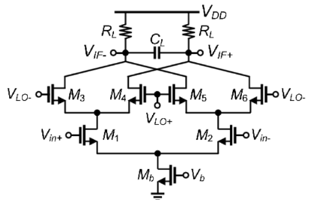
Double-balanced Gilbert mixer:
Fig 3. Double-balanced Gilbert mixer

Slide 8
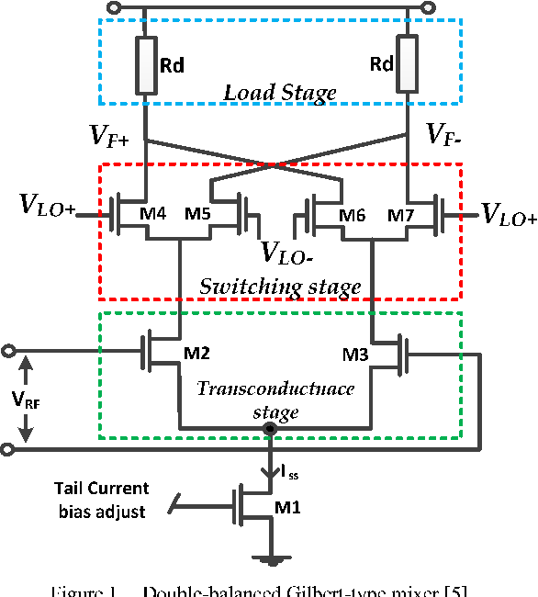
Block Diagram
Load Stage
Switching Stage
Transconductance stage
Fig 4:Double-balanced Gilbert mixer block Diagram

Slide 9
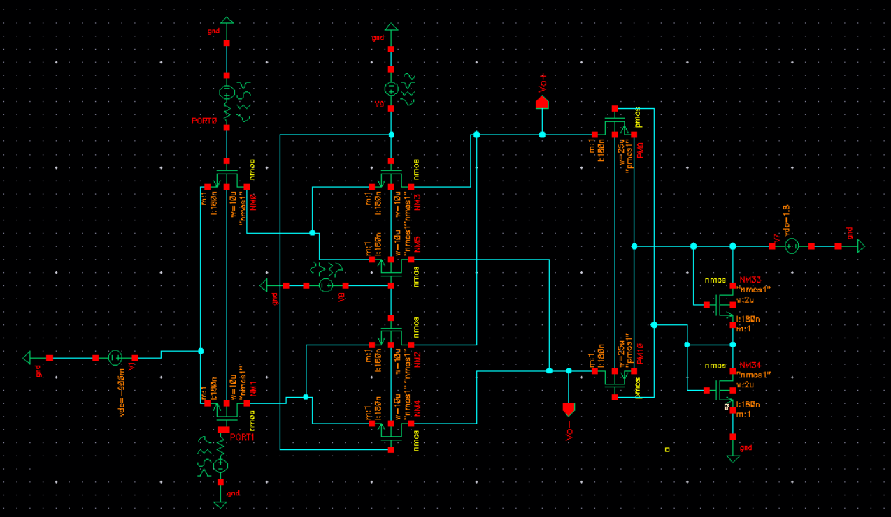
Circuit Design
Abstract:
Supply Voltage: 1.8 V
RF Values:
V_{rf} = 90mV_{pp}
Frequency(ω_{rf}) = 9.9 GHz
LO Values:
V_{Lo} =1.8V
Frequency(ω_{lo} )= 10 GHz
Sizing :
Pmos: 25u
Nmos: 10u
Fig5:Proposed Mixer Circuit Design.

Slide 10
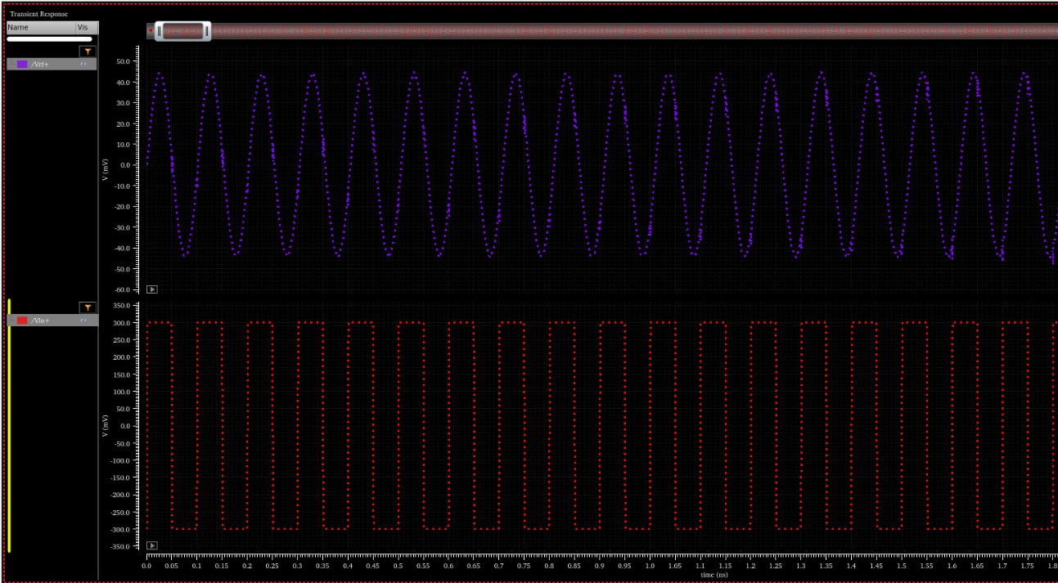
Input Parameters and Waveforms:
V_{rf+}= 90sin(ω_{rf}.t)mV_{pp}
V_{rf-}= -90sin(ω_{rf}.t)mV_{pp}
V_{lo+}= 0.6V sq. w(ω_{lo})
V_{lo-}= -0.6V sq. w(ω_{lo})
Fig 6. Waveforms of Input RF voltages and Voltage of local oscillator

Slide 11
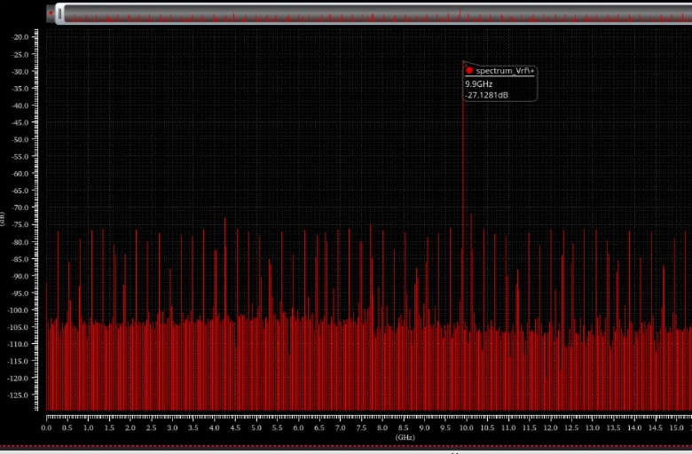
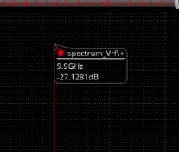
Input Parameters and Waveforms:
Measurement: FFT( V_{RF})
A peak at 9.9GHz
Fig 7: FFT of the I/P RF

Slide 12
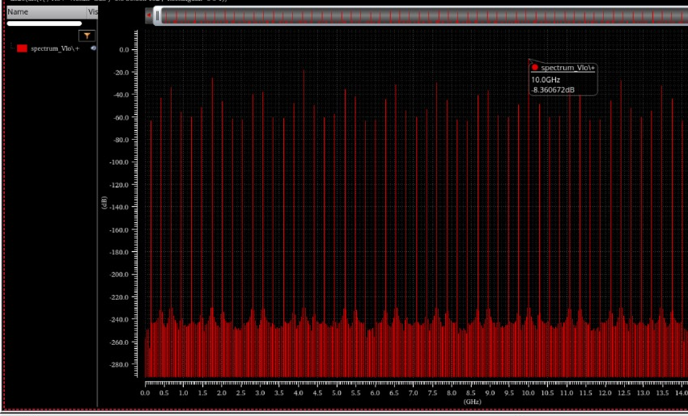

Input Parameters and Waveforms:
Measurement: FFT( V_{LO})
A peak at 10GHz
Fig 8: FFT of the Local Oscillator (LO)

Slide 13
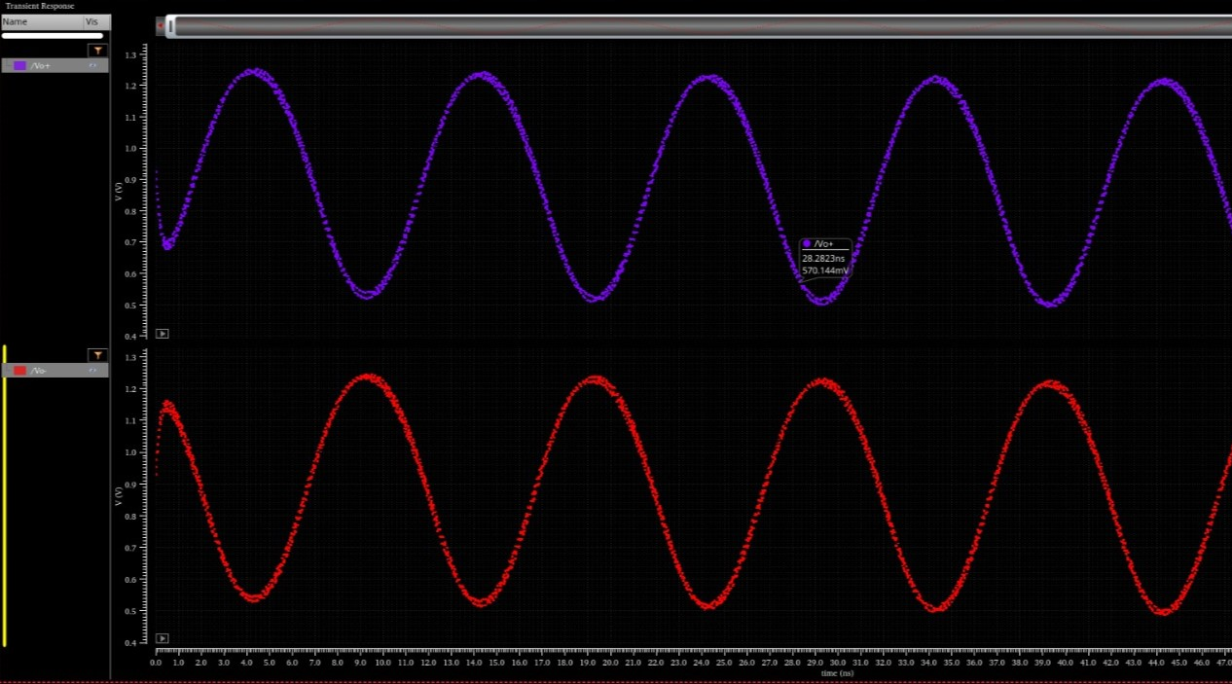
Output Parameters:
V_{o+}= -g_{m}R_{L}A.cos(ω_{rf}t) 1, 1st half
-1,2nd half
V_{o-}= +g_{m}R_{L}A.cos(ω_{rf}t) 1, 1st half
-1, 2nd half
Fig 9. Output Response ( V_{o+} and V_{o-} )

Slide 14
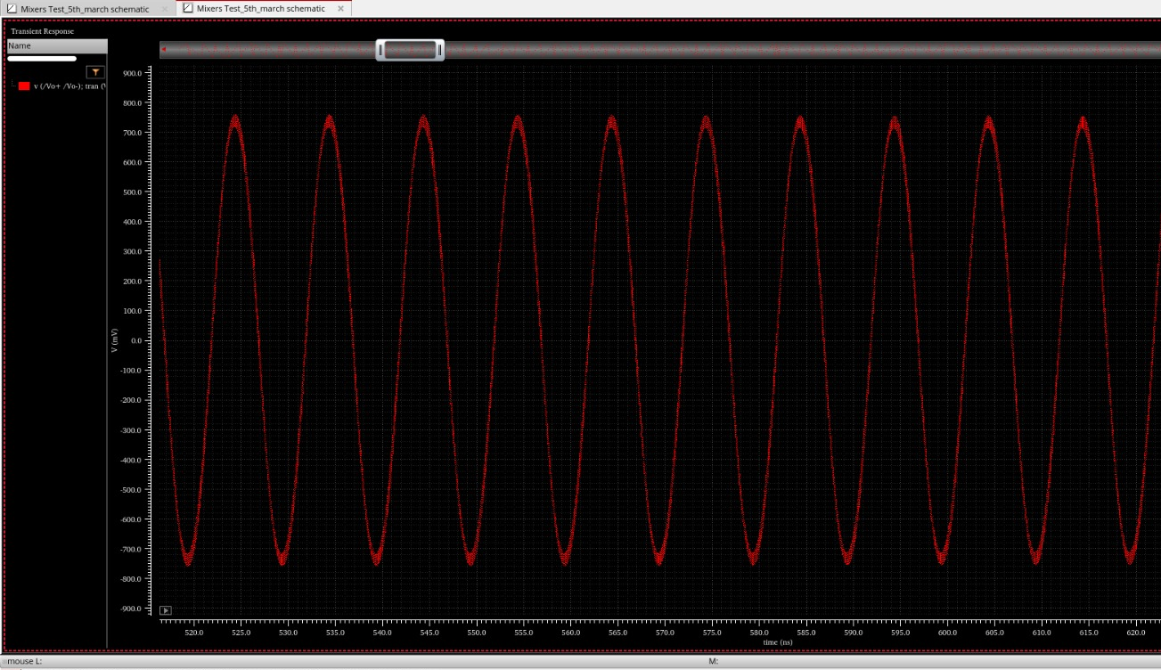
Output Parameters:
Difference of Output Node Voltages
V_{0net}= V_{o+} - V_{o-}
= -2.g_{m}R_{L}A.cos(ω_{rf}t)
. 1, 1st half
-1, 2nd half
Fig10. Differential Output response

Slide 15
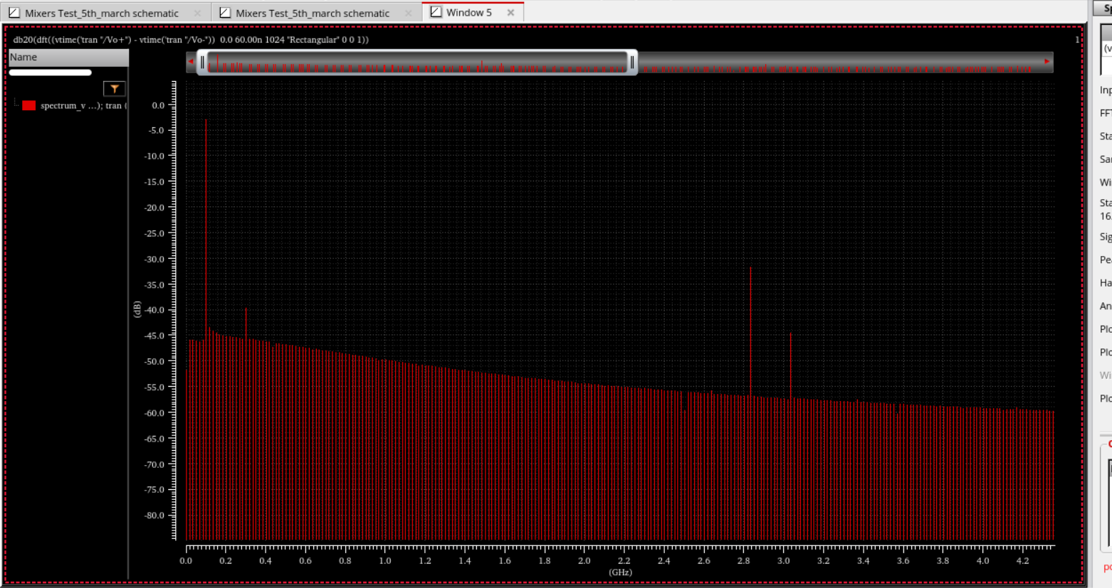
Output Parameters:
Measurement: FFT
Gain:(at 100MHz)
Fig11. FFT of the Proposed Mixer Output.

Slide 16
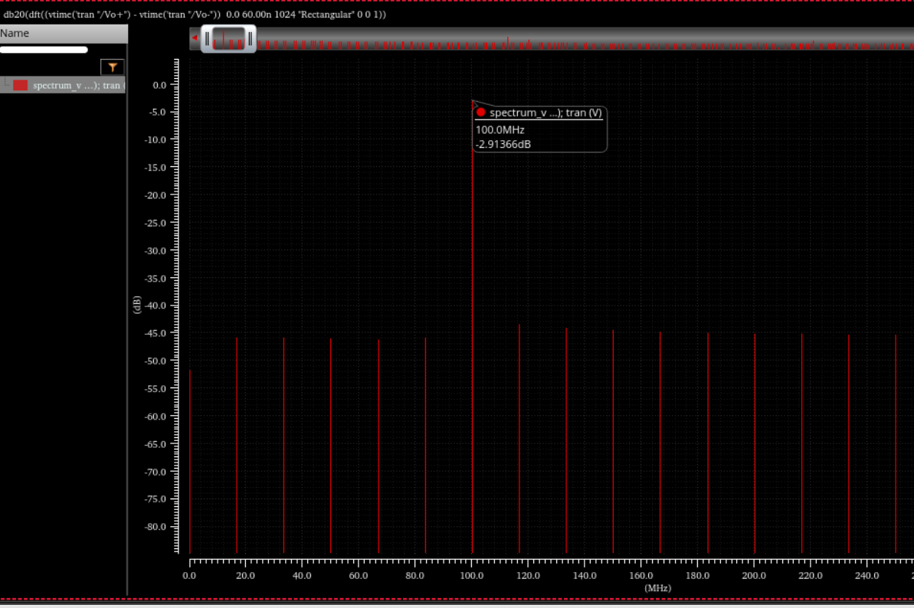
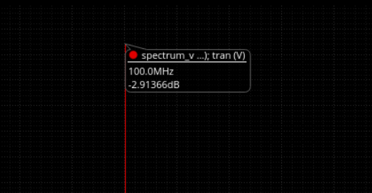
Output Parameters:
Measurement: FFT
Gain:(at 100MHz)
Fig12. FFT of the Proposed Mixer Output.

Slide 17
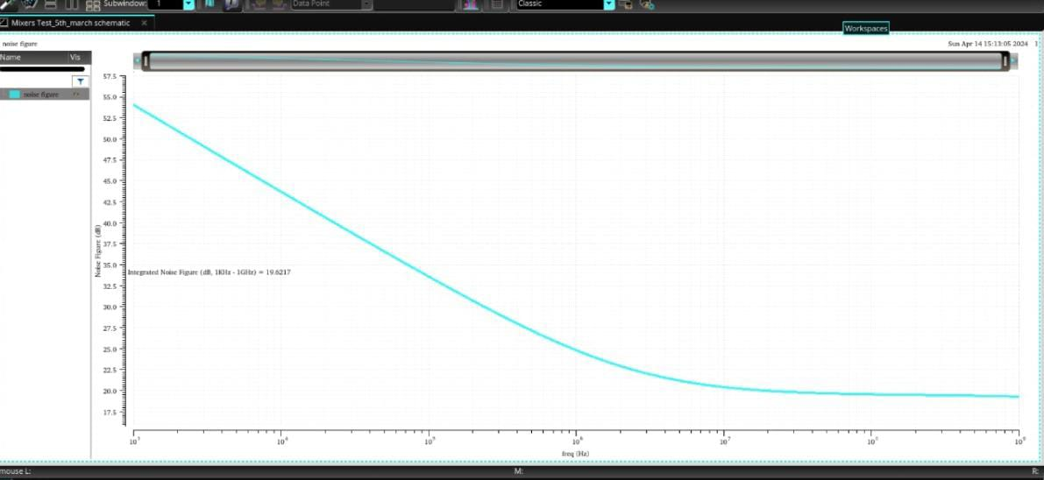
Output Parameters:
Noise Figure
Fig13. Noise Figure of the proposed Mixer

Slide 18
Output Parameters:
I/P Voltage (V _{pp}) | O/P Voltage (V _{pp}) | Gain (in dB) | Noise Figure
720mV | 3.82V | 14.682 | 19.784
360mV | 2.73V | 18.093 | 19.784
180mV | 2.45V | 23.1952 | 19.784
90mV | 1.45V | 24.1198 | 19.784

Slide 19
Calculations:
Conventional Gain:
For the 1st half of LO, V_{lo+} :High, V_{lo-} : Low
M₂, M₅ : ON , M₃, M₄ : OFF.
Find the O/P due to V_{RF+}
V_{RF-} will be off.
I₀₆ = 0, The + ve O/P ; V_{O1+RF+} = -R_{L}(I₂ +I₄)
Here, I₀₄ = 0
Therefore,
V_{O1+RF+} = -R_{L}I₂ = - R_{L}I_{O1}
= - R_{L}g_{m}( V_{gs} + V_{RF+})
V_{O1-RF+} = -R_{L}(I₃ + I₅) = 0
O/P due to V_{RF+};
V_{0RF} = V _{o1}⁺_{RF}⁺ - V_{o1}⁻_{RF}⁺
= -g_{m}R_{L}(V_{gs} +V_{Rf+})
1
2

Slide 20
Calculations:
(ii) O/P due to V_{RF-} only:
V_{O1+RF-}= -R_{L}(I₂ + I₄) = 0
V_{O1-RF-} = -R_{L}(I₃ + I₅) = -R_{L}(0 + I₀₆)
= -R_{L}(g_{m})[ V_{gs} + V_{RF}⁻]
Therefore,
V_{o1}⁻_{RF}⁻ = - R_{L}g_{m}( V_{gs} + V_{RF-})
V_{01RF}⁻ = V _{o1}⁺_{RF}⁺ - V_{o1}⁻_{RF}⁺
V_{01RF}⁻ = -g_{m}R_{L}(V_{gs} +V_{Rf+})
Therefore, The O/P for the 1st half of LO :
V_{O1} = V _{o1RF}⁺ + V_{o1}⁻_{RF}⁺
= -g_{m}R_{L}A.[COS(ω_{rf})]
Similarly,
V_{O2} = -g_{m}R_{L}A.[COS(ω_{rf})]
3
4

Slide 21
Calculations:
{
The complete O/P :
V_{O} = -g_{m}R_{L}A.COS(ω_{rf}). + 1, 1st half
- 1, 2nd half
= -g_{m}R_{L}A.COS(ω_{rf}).(4/₶).COS(ω_{lo}t)
V_{O} = -2 G_{c}R_{L}A.COS(ω_{rf}).COS(ω_{lo}t)
5
Note:
GC=(2/ ₶)g_{m}R_{L}

Slide 22
Simulation Results:
Schematic Description: The proposed schematic depicts a balanced Gilbert cell frequency mixer utilising 180nm CMOS technology. It is designed using the Cadence Virtuoso schematic editor.
RF frequency: 9.9GHz , LO frequency :10GHz.
Conversion Gain: The voltage conversion gain of the mixer is determined to be approximately 24.1198 dB, indicating its efficiency in converting input signal power to output voltage.
Noise Figure: The noise figure of the mixer is measured to be 19.784 dB, showcasing its ability to maintain signal integrity while minimising added noise.
Technology Node: The mixer uses 180nm CMOS technology, suggesting a relatively mature process node with moderate integration density and performance characteristics.

Slide 23
Simulation Results:
6. Tool Used: The schematic design uses the Cadence Virtuoso schematic editor, a widely used tool for analogue and mixed-signal circuit design in the semiconductor industry.
7. Validation: The schematic design undergoes successful verification, ensuring its functionality and adherence to design specifications before fabrication or further optimisation.

Slide 24
Future Scope of Extension:
On Chip Integration
High Linearity
6G Applications.
Low-Power Operation.
RF Signal Processing.

Slide 25

Conclusion:
A CMOS double-balanced down conversion Gilbert-cell frequency mixer with input Radiofrequency of 9.9GHz and LO frequency of 10 GHz is designed using 180nm CMOS technology. The Cadence Spectre simulator is used for simulation. The mixer is operated at a low voltage of 1.8V supply. The voltage conversion gain of the proposed double-balanced Gilbert cell mixer is 24.1198dB, and the noise figure is around 19.78 dB. Hence, the mixer is appropriate for the development of the radio frequency receiver front-end application.

Slide 26
References:
[1] D K Sushmitha "A 2.4GHz CMOS Double Balanced Down Conversion Gilbert Cell Mixer Design Using 180nm Technology" 2018 3rd IEEE International Conference on Recent Trends in Electronics, Information & Communication Technology (RTEICT)
[2] Yang Liu "A 0.18um 3.3mW double-balanced CMOS active mixer"2007 7th International Conference on ASIC.
[3] Anju Katarmal "RF CMOS Double Balanced Gilbert Cell Mixer for5G Application"2021 3rd International Conference on Signal Processing and Communication (ICPSC)
[4] No Gil Myoung and Seong Su Park, "A Novel CMOS Down-conversion Mixer with Current-Reuse Technique", IEEE APMC Proceedings, 2005
[5] RF Microelectronics by B. Razavi.

Slide 27
Thank You

